Slide 1

PROCESS MINING VIRTUAL INTERNSHIP
by
B.SABREEN TAJ
. 214G1A3289
Department of Computer Science and Engineering (Data Science)
Srinivasa Ramanujan Institute of Technology
(Affiliated to JNTUA & Approved by AICTE) (Accredited by NAAC with ‘A’ Grade & Accredited by NBA (EEE, ECE & CSE)
Rotarypuram Village, B K Samudram Mandal, Ananthapuramu – 515701.
2023 - 2024

Slide 2

Contents
Course Objective
Introduction
Technology
Applications
Modules
Real Time applications
Learning outcomes
GitHub Link
Queries

Slide 3
Course Objective: TO KNOW ABOUT PROCESS MINING
Point 1
Process mining applies data science to discover, validate and improve workflows.
provides companies a modern way to run their business processes entirely on data and intelligence.
Point 2
Ex : receiving an order, submitting a piece of documentation, approving
a loan, entering information into a health record, etc.
energy savings - energy wastage is reduced when your plant and machinery are efficiently operated. improved safety - control systems automatically warn you of any abnormalities which minimizes the risk of accidents. consistent product quality - variations in product quality are kept to a minimum and reduce your wastage.
Generate process maps capturing different process variants with the sequence of tasks/steps involved.

Slide 4
INTRODUCTION
What is a Process?
A process is very simply a series of linked actions or steps taken in order to achieve a particular end.
Process mining is based on event logs. We can describe event logs as a sequence of sequences of events.
Process mining starts from eventdata. Input for process mining is an event log.An event log views a process from a particular stage/angle.
What is meant by process mining?
Process mining is a technique designed to discover, monitor and improve real processes (i.e., not assumed processes) by extracting readily available knowledge from the event logs of information systems.
Ex: Characterize each patient's hospital journey as a process, starting from when they are admitted to when they are discharged.
Event log: Process mining assumes the existence of an event log where each event refers to a case, an activity, and a point in time.

Slide 5
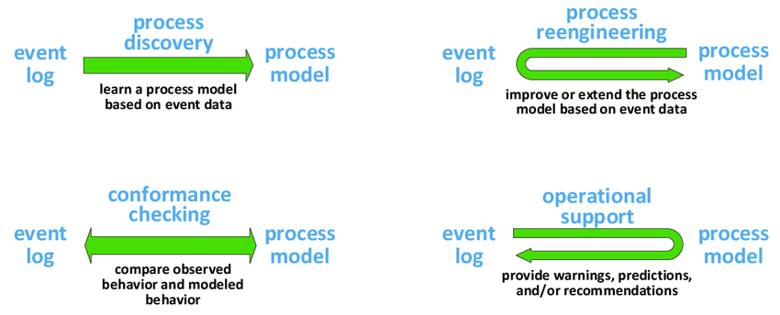
TECHNOLOGY
The four basic types of process mining: (1) process discovery, (2) conformance checking, (3) process reengineering (changing the process model), and (4) operational support (influencing the process without reengineering it).
1.Process Discovery: It is a process mining technique used to create a data-based visualization of process workflows.
2.Conformance Checking: Conformance checking is a technique used to check process compliance by comparing event logs for a discovered process with the existing reference model (target model) of the same process.

Slide 6
CONTINUED……..
3.Process Reengineering: process reengineering is the redesign of existing processes to improve efficiency, quality,and customer satisfaction.It involves analyzing and rethinking workflows to eliminate unnecessary steps.
4.Operational Support: These teams handle tasks such as monitoring systems, providing technical assistance, managing incidents, and ensuring efficient workflows.
Types of OSS Classified into the following categories:
a. Transaction Processing Systems
b.Process control system
c.Enterprisecollaborationsystem

Slide 7
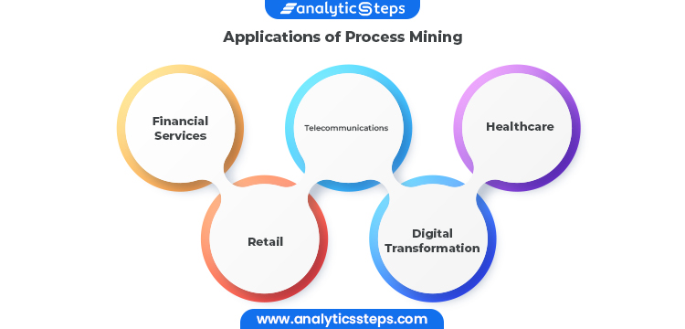
APPLICATIONS

Slide 8
Applications
Financial Services:
Because of the rise in transaction volume and the digitization of more industries, aberrant activity is harder to detect using manual methods. Companies in the financial services sector have the chance to continually and thoroughly identify issues within high-volume processes thanks to process mining, which is a solution to the increased regulatory and audit requirements.
Healthcare:
The risks associated with preserving population health and achieving individual patient journey objectives rise as data about patient experiences and results keep growing. Process mining supports the delivery of effective and high-quality end-to-end patient journeys for healthcare organizations dealing with the exponential growth of data, from before a first doctor appointment through treatment regimens to closed treatment cases…

Slide 9
MODULES:
1.Business Module : Process mining is a widely-used technology to model, analyze, and optimize business processes. Think of a MRI that shows how your processes actually run — not how you think they run.
For example, a process mining case study from Nokia adapts its purchase-to-pay and order-to-cash processes to achieve a smooth customer experience. By mining its processes, Nokia obtained the necessary knowledge of how to conjugate these processes.
Advantages of Business Model :
A good business Model gives the company a competitive edge.
Good Business Model provides good reputation in the market place encouraging the investors.
Making the business Model strong leads to an ongoing business profit which increases cash reserves.

Slide 10
CONTINUED….
2.Technical module : Process mining utilizes this data from IT systems to create a process model, or process graph. From here, the end-to-end process is examined, and the details of it and any variations are outlined. Specialized algorithms can also provide insight into the root causes of deviations from the norm.
For example, a process mining case study from Nokia adapts its purchase-to-pay and order-to-cash processes to achieve a smooth customer experience. By mining its processes, Nokia obtained the necessary knowledge of how to conjugate these processes.
Advantages of technical :
1.Easy to understand.
2.Represented in graph models.
Reduced fraud and increased organizational efficiency
are only two benefits of data mining.

Slide 11
CONTINUED….
Process Mining Fundamentals : This training track provides you with insights into both the theoretical and applied foundations around Process Mining.
In process mining, a process is sequence of events (discrete actions) that are executed to reach a particular goal or outcome. For example, we can characterise each patient's hospital journey as a process, starting from when they are admitted to when they are discharged.
Advantages of process mining fundamentals :
Reduce costs. ...
Reduce lead time. ...
Improve quality. ...
Improve customer satisfaction. ...
Enable process automation…

Slide 12
REAL TIME APPLICATIONS:
Healthcare centers : In process mining, a process is sequence of events (discrete actions) that are executed to reach a particular goal or outcome. For example, we can characterise each patient's hospital journey as a process, starting from when they are admitted to when they are discharged.
example of process mining in real time : Let's take a sales order, for example. With traditional process mining, a customer has a relationship with their sales order.
It's a one-to-one relationship. But in reality this customer has not one, but three different sales orders.
Banking : In the banking industry, process mining can be applied to various areas to improve operational efficiency and customer experience.
Process mining can be used to visualize the customer journey through various sectors.
Such as account opening ,loan approval, transaction proccessing, and more.

Slide 13
Learning outcomes:
1.Improved quality and performance.
2.Competitive advantages.
3.Visibility.
4.Less risks.
5.Cost efficiency.
6.Improved scalability.
OUTCOMES OF PROCESS MINING

Slide 14
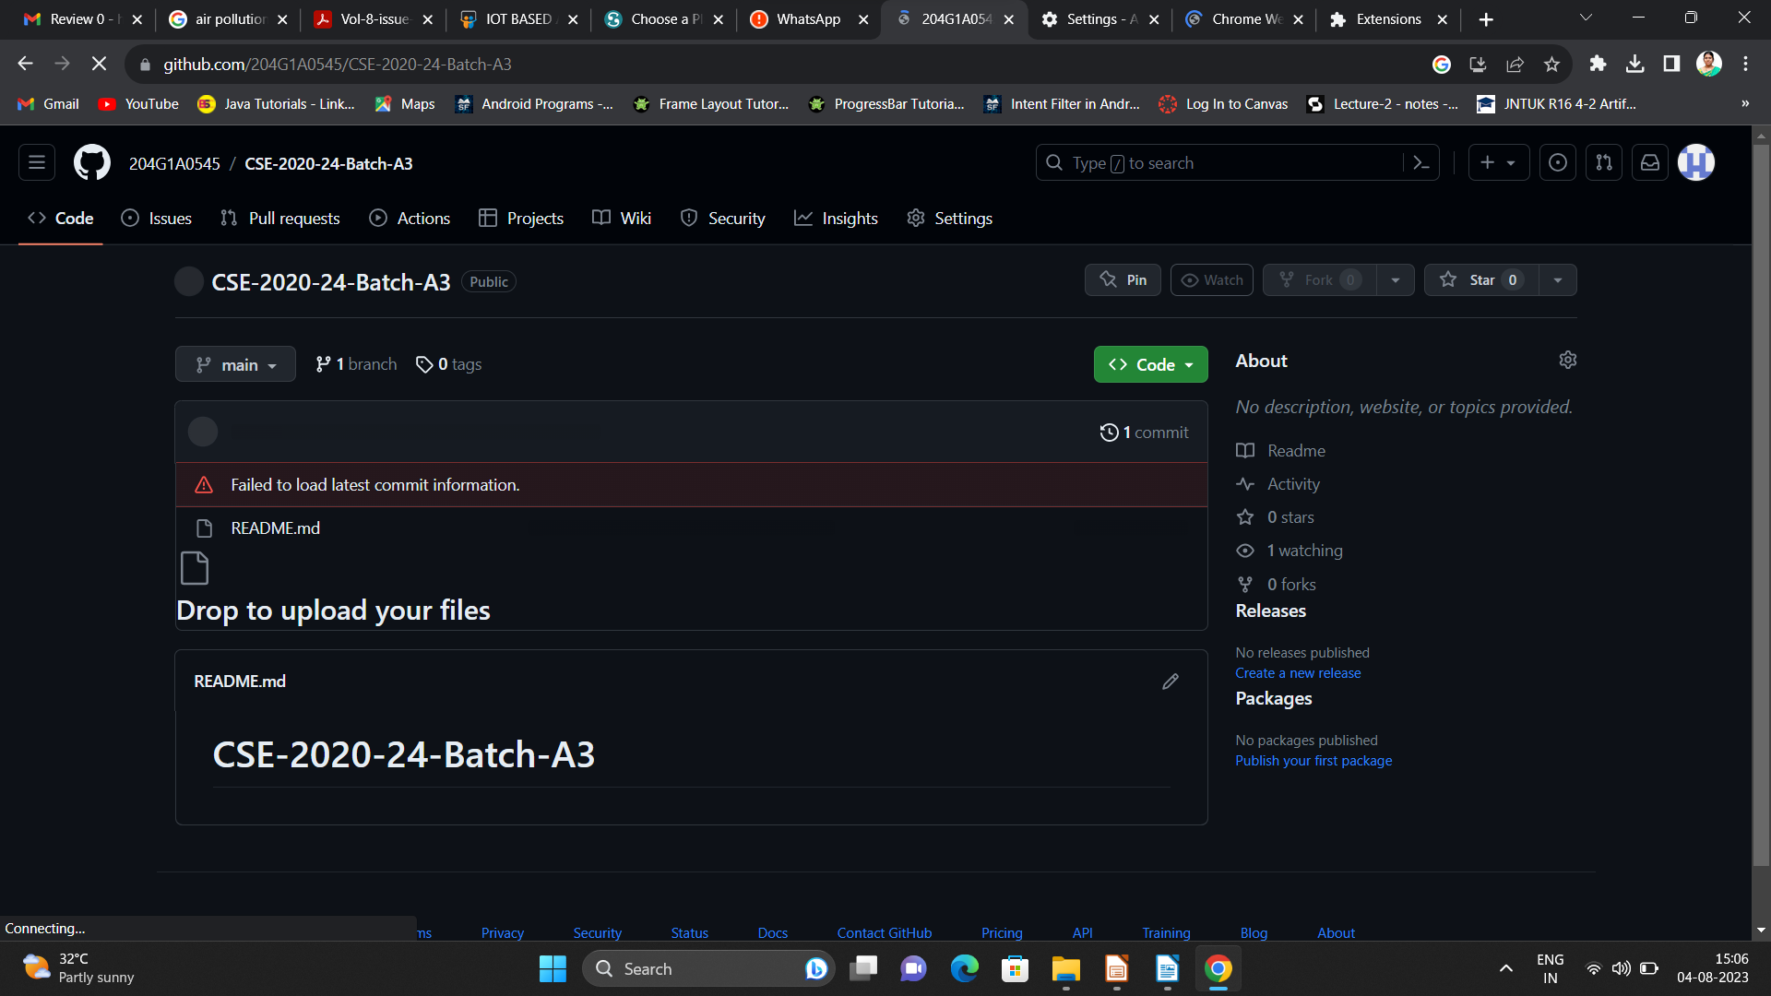

Git Hub Dashboard
Repository Name Like: Summer Internship - I
Under that include document, presentation and Certificate(Pdf).

Slide 15
Any Queries?

Slide 16
Thank You!!!

